Slide 1
Message Authentication Code (MAC)

Slide 2
Introduction
The concept of Message Authentication Code (MAC) is quite similar to that of a message digest. However, there is one difference. There is no cryptographic process involved in the case of message digests.
In contrast, a MAC requires that the sender and the receiver should know a shared symmetric (secret) key, which is used in the preparation of the MAC. Thus, MAC involves cryptographic processing.

Slide 3
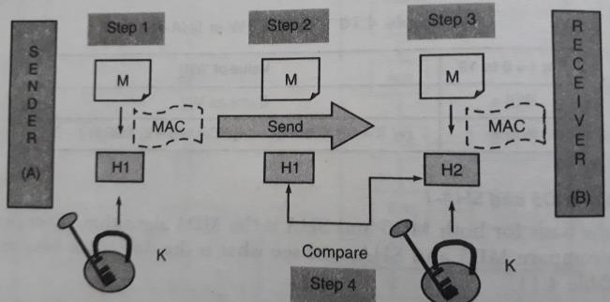
Message Authentication Code (MAC)

Slide 4
Interestingly, although the calculation of the MAC seems to be quite similar to an encryption process, it is actually different in one important respect. As we know, in symmetric-key cryptography, the cryptographic process must be reversible. That is, the encryption and decryption are the mirror images of each other. However, note that in the case of MAC, both the sender and the receiver are performing encryption process only. Thus, a MAC algorithm need not be reversible—it is sufficient to be a oneway function (encryption) only

Slide 5
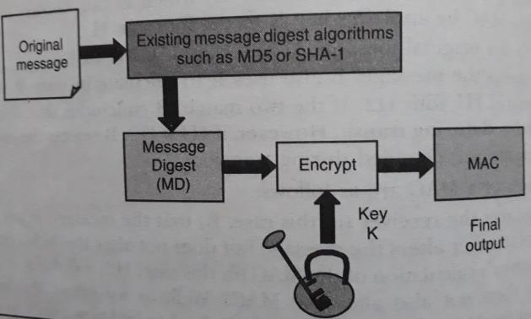
Hash-based Message Authentication Code (HMAC)

Slide 6
Working of HMAC
Variables that will be used in HMAC are as follows:
MD = The message digest / hash function used
M = The input message whose MAC is to be calculated
L = The number of blocks in the message M
b = The number of bits in each block
K = The shared symmetric key to be used in HMAC
ipad = A string 00110110 repeated b/8 times
opad = A string 01011010 repeated b/8 times

Slide 7
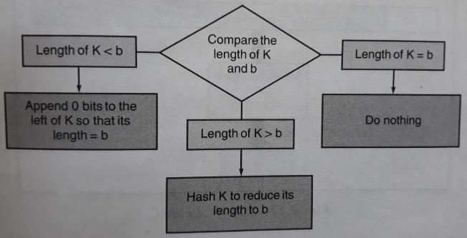
Step 1: Make the length of K equal to b

Slide 8
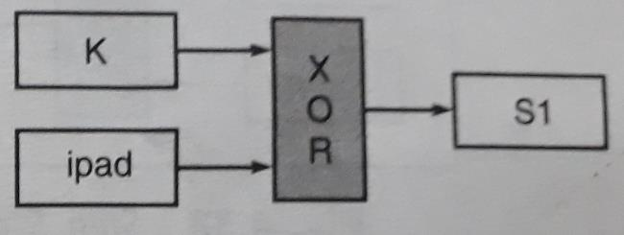
Step 2: XOR K with ipad to produce S1

Slide 9
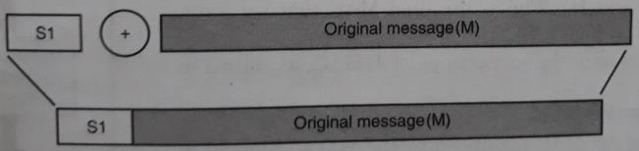
Step 3: Append M to S1

Slide 10
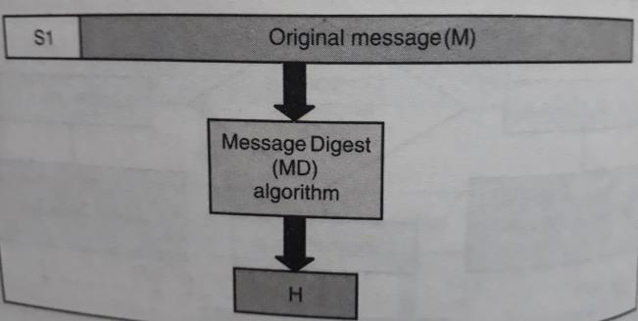
Step 4: Apply MD algorithm

Slide 11
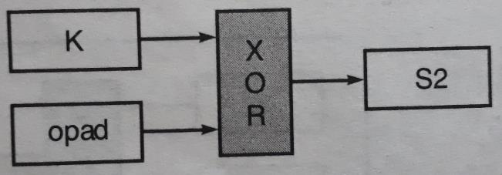
Step 5: XOR K with opad to produce S2

Slide 12
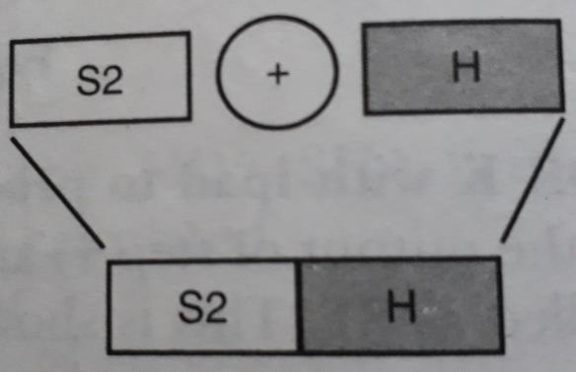
Step 6: Append H to S2

Slide 13
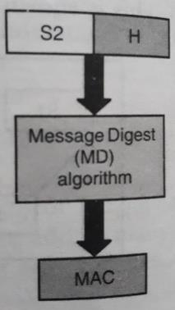
Step 7: Apply message digest algorithm

Slide 14
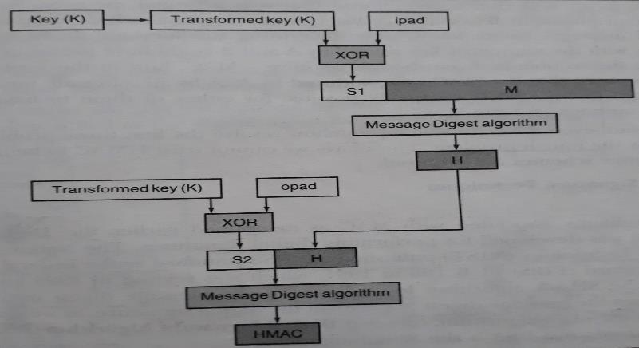
Complete HMAC operation

Slide 15
Disadvantages of HMAC
Problem of Key exchange
How to use a single symmetric key when multiple receivers are there?
Are both the sender and receiver trustworthy?

Slide 16
Thank You

